Slide 1

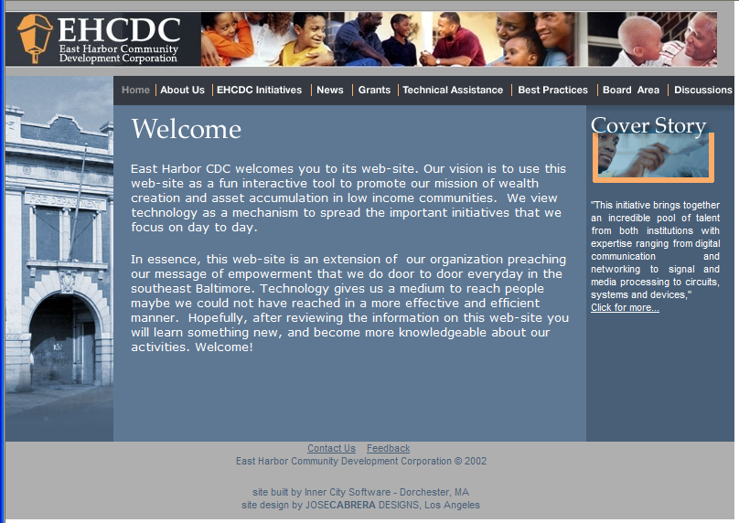
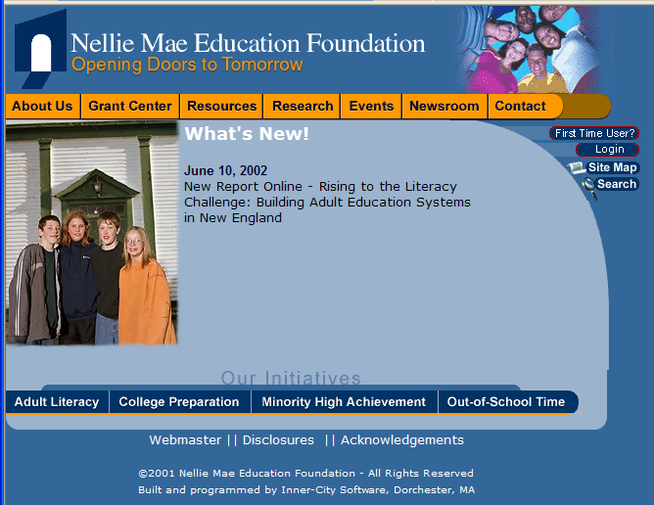



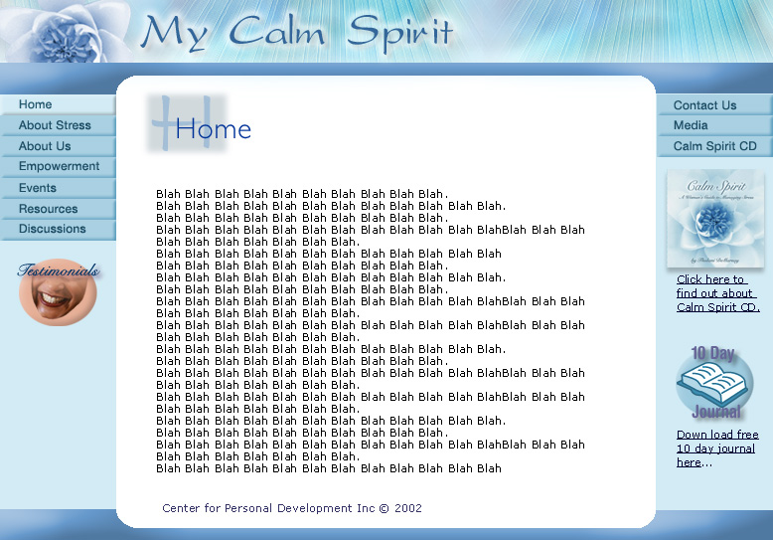

ICS Web Site Offerings

Slide 2
Overview
Inner-City Software is committed to providing affordable, state-of-the-art web presences to organizations and businesses that serve and benefit low-income communities and communities of color.

Slide 3
Pricing Model
Feature Design
Visual Design
Programming/Integration
Content
Hosting
Maintenance

Slide 4
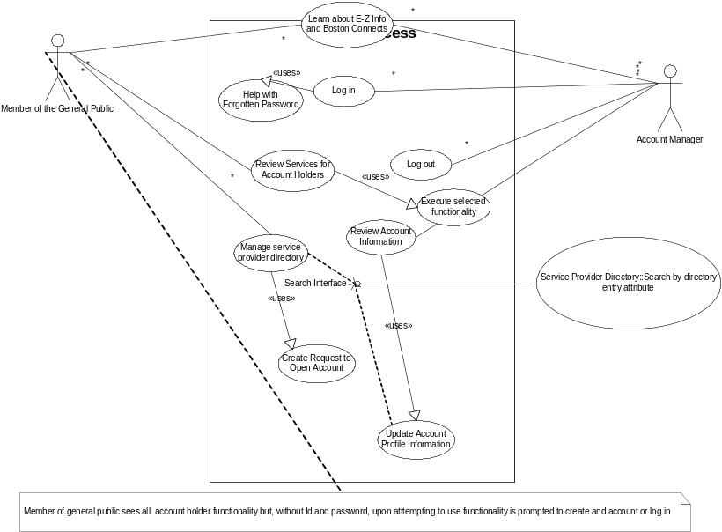
Feature Design
What will the site DO?
  Show Brochure
  Collect/Show News
  Collect/Show Events
  Collect/Play Audio/Video Programs
  Post/Show Discussions
  Live Chats
  Collect Registration Info
  Send E-Mail

Slide 5

Visual Design
How will the site LOOK?
  Colors
  Layout
  Feel
  Navigation

Slide 6
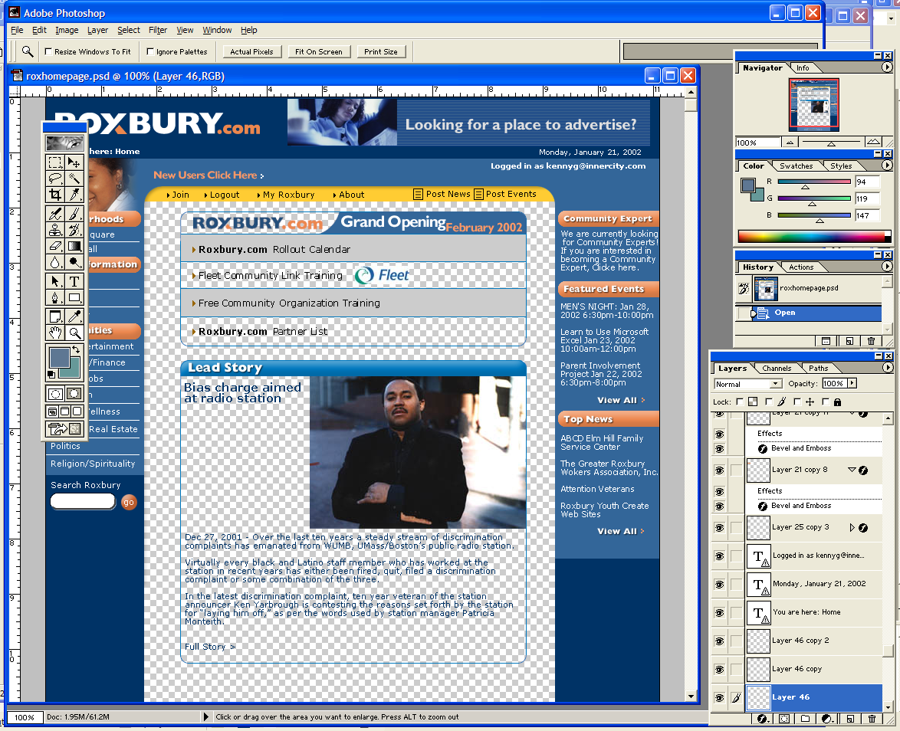
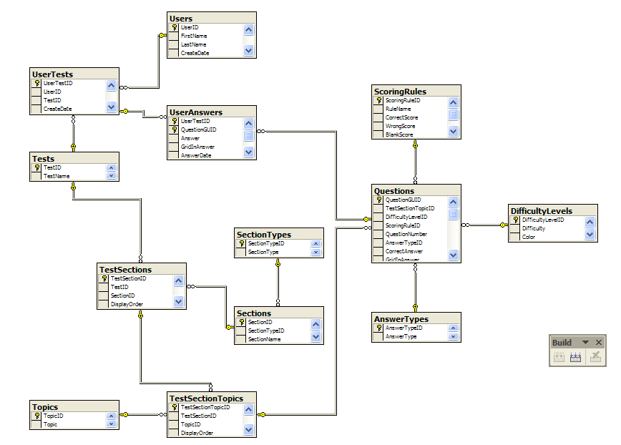

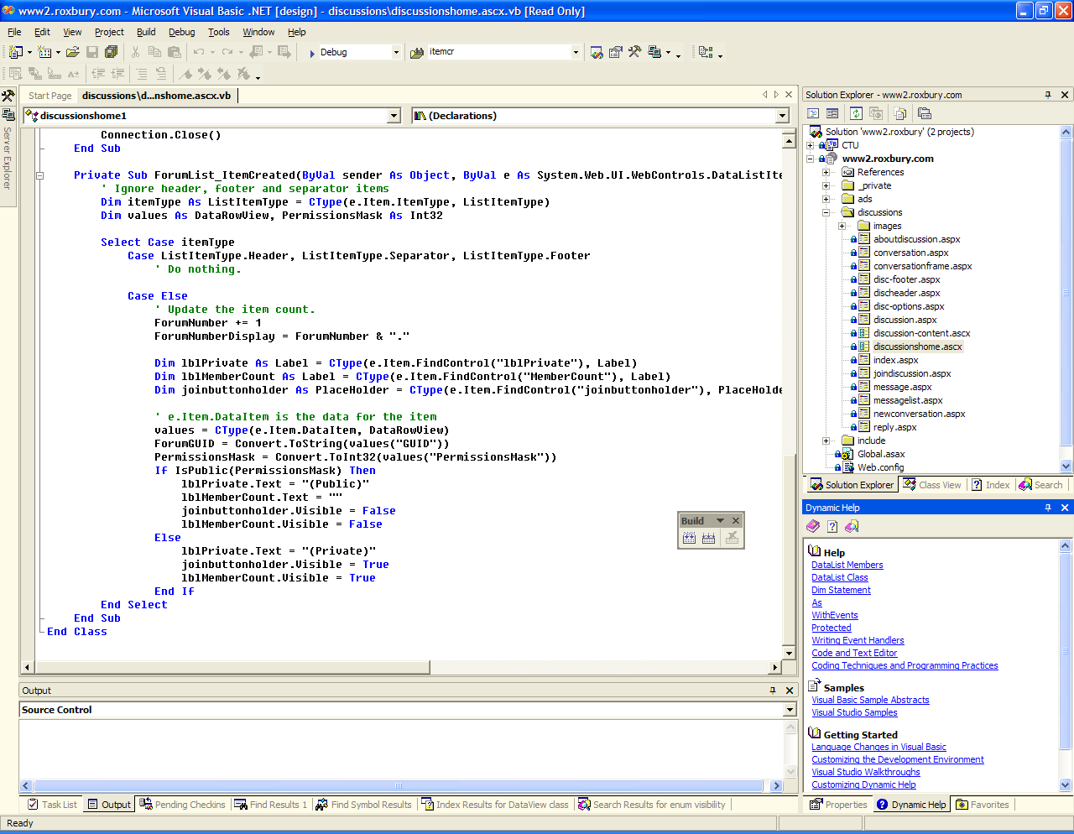
Programming/Integration
Implementing Feature/Visual Designs

Slide 7
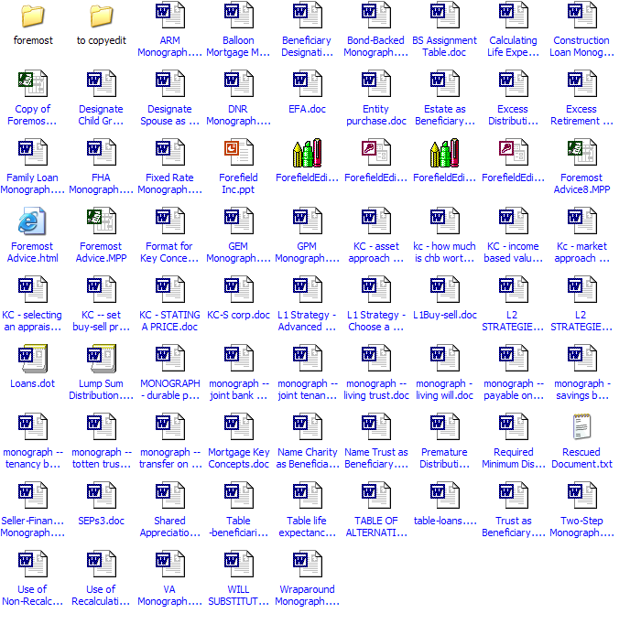

Content
Writing informational/instructional/narrative text

Slide 8
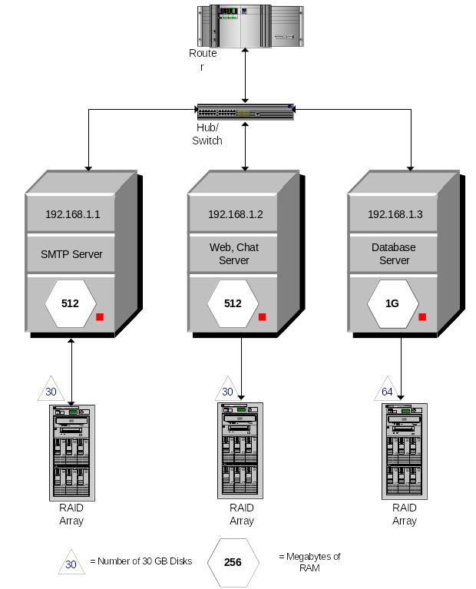
Hosting
Making site available to the public

Slide 9

Maintenance
Tweaks, updates, enhancements

Slide 10
Offerings by Budget
Zero Budget
  Roxbury.com
$1000-$5000
  Virtual News Syndicate
$5000-$10000
  Basic Custom Presence
$10000 and Up
  Enhanced Custom Presence

Slide 11

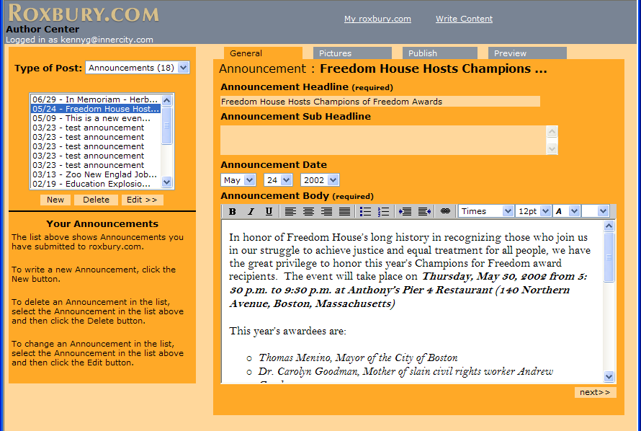
Zero Budget
Roxbury.com
  Post Announcements
  Post Articles
  Post Events
  Requires Approval from Community Admin
  No “Branded” Areas Yet
  No Costs
  No Creative Control

Slide 12

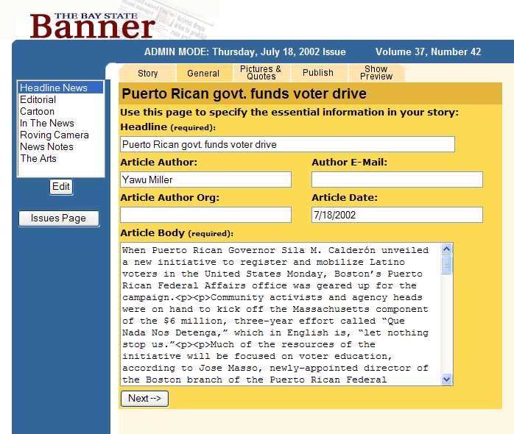
$1000-$5000
Virtual News Syndicate
  Post Articles
  Content Appears Immediately
  “Branded” Presence Available
  Content can be Syndicated
  Limited Creative Control

Slide 13


$5000-$10000
Basic Custom Presence
  Post Articles
  Post Events
  Host Public/Private Discussion Forums
  Content Appears Immediately
  “Branded” Presence
  Content can be Syndicated
  Complete Creative Control

Slide 14

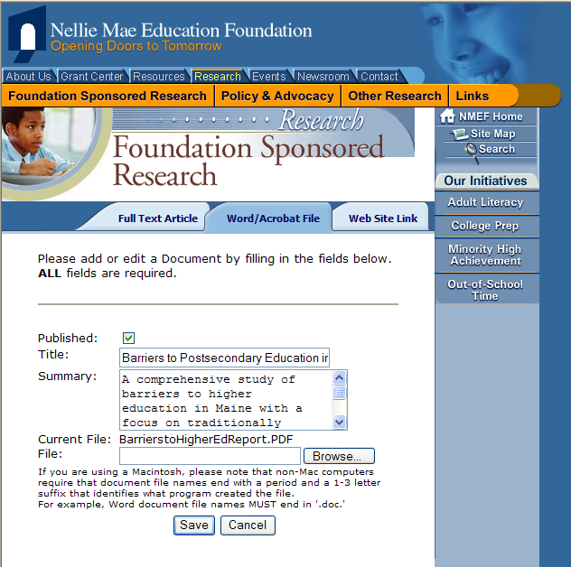
$10000 and Up
Enhanced Custom Presence
  Post Articles
  Post Events
  Host Public/Private Discussion Forums
  Multiple Levels of Security
  Personalized Content
  Content Appears Immediately
  “Branded” Presence
  Content can be Syndicated
  Complete Creative Control
  Higher-End Design
  Higher-End Feature Set

Slide 15
Offerings Pros and Cons
Roxbury.com
  Pros Cons
  Free No creative control
Virtual News Syndicate
  Pros Cons
  Low Cost Limited creative control
  Permits Branded
  Presence
  Enables Syndication
Basic/Enhanced Custom Presence
  Pros Cons
  Features only More complex pricing
  constrained by models
  budget

